Slide 1
So You Want to Be a SharePoint Developer, After ~60 Minutes you can be a SharePoint Padawan
SharePoint Saturday New York
7/30/2016

Slide 2


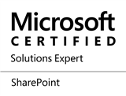
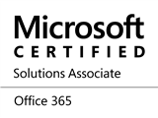

Ryan Schouten
Worked with SharePoint for 9 years
I have experience with SharePoint 2003 – 2013
I have worked with ASP.Net for 14 years
MCPD, MCT, MCSE: SharePoint, MCSA: Office 365
Contact Information
Ryan@sharepointknight.com
@shrpntknight
http://www.sharepointknight.com
Notes:
Worked with all but one version of SharePoint. I missed the first version. Slides will be posted to my blog at http://www.sharepointknight.com in the next 24 hours.

Slide 3

Office365 Implementations/Migrations
Custom SharePoint Development
Responsive Design
Intranet Design/Implementations

Slide 4


Slide 5
Progression
Youngling(Initiate)
Padawan
Knight
Master

Slide 6
SharePoint Basics
Items and Files
Web Application
Site Collection
Web Site
Lists and Libraries

Slide 7
Site Collection
Contains A Web Site at its Root
Boundary for a lot of SharePoint
Security
Content Access
Databases

Slide 8
Web Site
Actually holds the content
Content is stored in lists and libraries
Can Contain Sub Sites

Slide 9
Lists and Libraries
Content inside SharePoint Stored in List Items and Files
They are like data tables/Excel Sheets
Allow storing of data with user definable fields

Slide 10
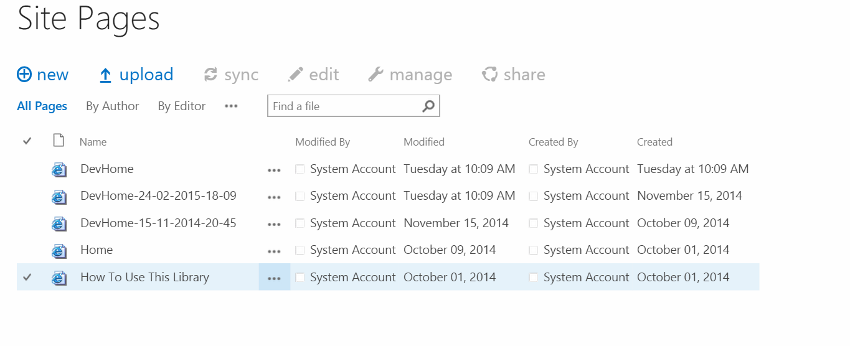
Views
Allows Users to Customize How Data is Viewed
Includes the Following Functionality
Grouping
Sorting
Filtering
Paging

Slide 11
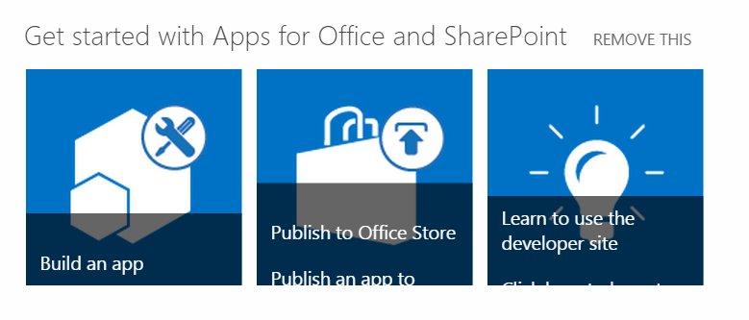
Web Parts
Web Parts are how SharePoint Displays Content
List Views are a Web Part

Slide 12
Workflows
Allows for Process Automation
SharePoint includes out of the box approvals
Approval
Collect Feedback
Collect Signatures
Publishing Approval
Three State
We can create our own

Slide 13
Search
Indexes Content for Quick Retrieval
Content is Cross Farm
Can Include Content from Non SharePoint Sources
Search can look across Millions of records in sub-second responses

Slide 14
Business Connectivity Services
Allows us to expose data from external systems in SharePoint as if it was Stored there
This can be data stored in:
SQL Server
Web Services
Oracle(with Custom Code)
Any .Net Accessible source

Slide 15
Enterprise Content Management
Allows Publishing and Approval of Content
Gives us the ability to use page layouts
Routing of content
Records Management

Slide 16
Security
Permissions can be granted to
Groups
Users
Apps
Groups can contain:
Users
AD Groups
Apps
Permissions Inherit by default but inheritance can be broken

Slide 17
But None of this achieves what I need
This is where your development skills come in to the picture
But beware of the dark side
Do not reinvent the wheel
Know what functionality comes out of the box
Be mindful of resources
Just because you can doesn’t mean you should

Slide 18
Different Ways of customizing SharePoint
Visual Studio
Full Trust Solution
Sandbox Solution
SharePoint Apps/Add Ins
Napa
SharePoint Apps/Add Ins
SharePoint Designer
Allows Easy Modification of SharePoint Items
Workflows

Slide 19

Full Trust Solutions
Allows Full Access to the SharePoint Environment
Can use VB.Net or C#
Allows the greatest degree of customization but can also cause the most harm
Files can be deployed to the SharePoint file system
Deployed as .wsp(really a cab)

Slide 20

Sandbox Solutions
Predecessor to SharePoint Apps
Allowed deployment of SharePoint resources
Admins could limit the amount of server resources solutions to prevent server degradation
Deployed as .wsp(really a cab)

Slide 21
SharePoint Apps/Add Ins
New to SharePoint 2013
Can be sold through the SharePoint App Store
Two Hosting Methods available
SharePoint Hosted
Provider Hosted
Deployed as .app(really a zip file)

Slide 22
Comparison
 | Full Trust | Sandbox | SharePoint Hosted App | Provider Hosted App
Server Side Code
Client Side Code
Server Side Object Model
Client Side Object Model
Custom Lists/Modules
Languages | VB.Net/C#/ JavaScript | VB.Net/C#/ JavaScript | JavaScript | Any Web Language
Availability | On Premise | On Premise/ Office 365 | On Premise/ Office 365 | On Premise/ Office 365

Slide 23
Working with SharePoint
Several Methods available for working with SharePoint
Server Side Object Model
Client Side Object Model
Web Services
REST

Slide 24
Server-Side Object Model
Full access to SharePoint
Pretty much if SharePoint can do it so can you
Watch for memory leaks.
If you create it and can dispose it, do so.
Items and Files - SPListItem
Web Application - SPWebApplication
Site Collection - SPSite
Web Site - SPWeb
Lists and Libraries - SPList

Slide 25
Client-Side Object Model
Comes in Several Flavors
.Net
Silverlight
JavaScript
Windows Phone
Allows Batching of Requests
Uses a lot of the same class names and methods

Slide 26
REST
Allows Quick Access to SharePoint Resources through URLs
Allows most Odata operators
Filter
Select
OrderBy
Etc.
http://sharepoint/_api/web

Slide 27
Compare
 | Server Side Object Model | Client Side Object Model | REST
Access SharePoint Objects
Run with Admin Priviledges
Can Be Used in the Browser
Full SharePoint Access
Availability | On Premise | On Premise/Office 365 | On Premise/Office 365

Slide 28
What Now
Select a Language
Find a Project
Choose a Mentor
Get Access to SharePoint
Get Started

Slide 29
Questions

Slide 30

You are now a SharePoint Padawan

